Slide 1

Artificial Intelligence
Policy Gradient Methods
Dr. Rajiv Misra, Professor
Dept. of Computer Science & Engg.
Indian Institute of Technology, Patna
rajivm@iitp.ac.in

Slide 2

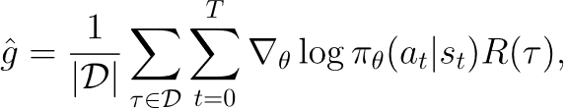
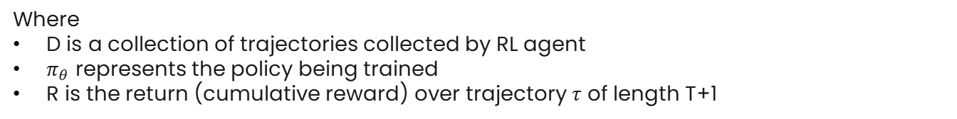
Recap – Simple Policy Gradient
We would like to optimize the policy by gradient ascent, eg
Simplest Policy Gradient is given by:
Where
D is a collection of trajectories collected by RL agent
$π_{θ}$ represents the policy being trained
R is the return (cumulative reward) over trajectory $τ$ of length T+1

Slide 3
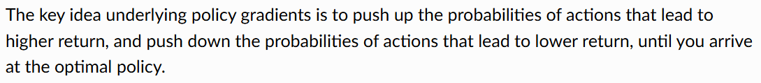
Vanila Policy Gradient Method (VGP)
VPG is an on-policy algorithm – this means that the trajectories used for training must come from agent’s own policy – i.e., the policy being trained. This is unlike DQN where we can use any policy to collect trajectories for training, hence DQN is off-policy algorithm.
VPG can be used for environments with either discrete or continuous action spaces. Unlike DQN which works on discrete action spaces only.

Slide 4
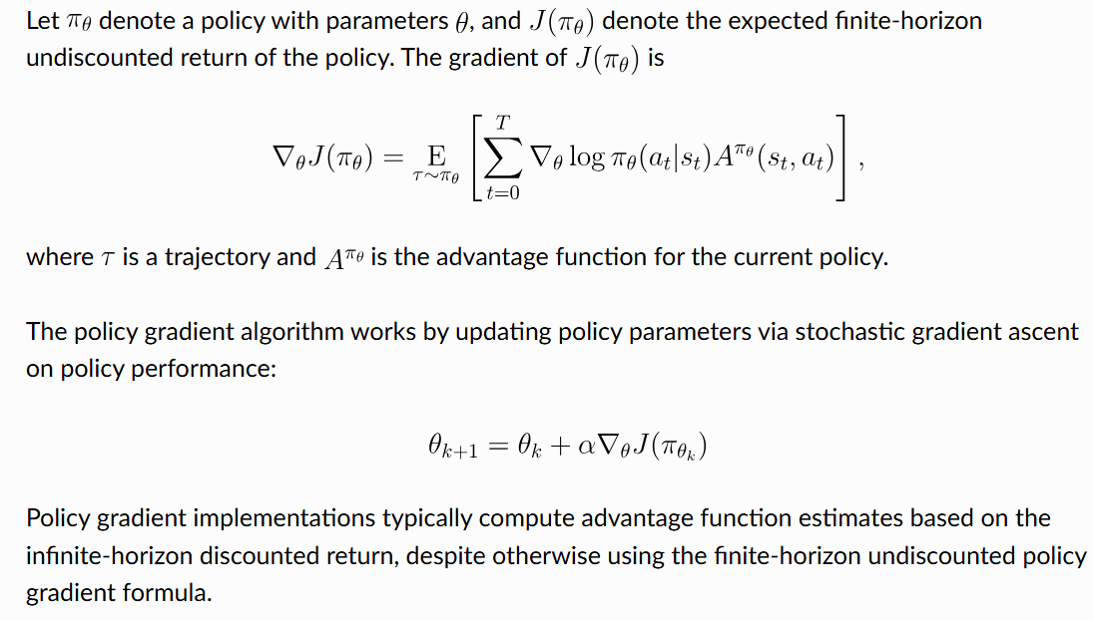
Formulation of VPG

Slide 5
Exploration vs. Exploitation
VPG trains a stochastic policy in an on-policy way. This means that it explores by sampling actions according to the latest version of its stochastic policy.
The amount of randomness in action selection depends on both initial conditions and the training procedure.
Over the course of training, the policy typically becomes progressively less random, as the update rule encourages it to exploit rewards that it has already found.

Slide 6
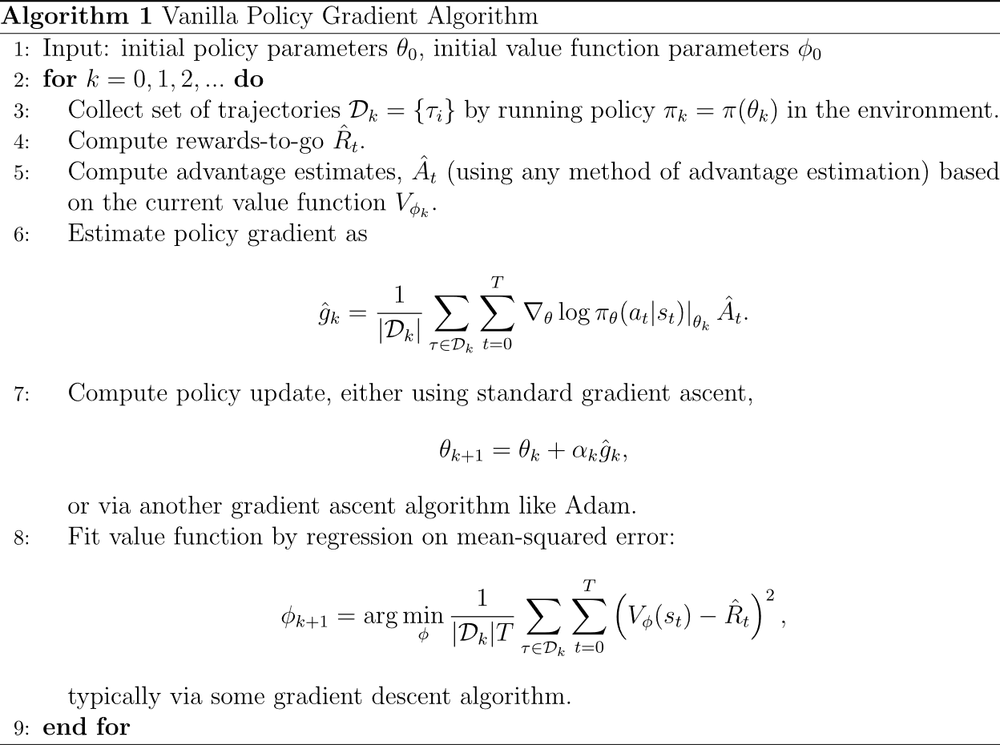

Slide 7
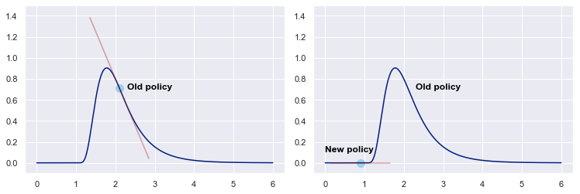
Problems with VGP - overstepping
The key challenge is to select the appropriate learning rate α for policy update
The first-order derivatives tell us in which direction to step, but not by how much.
In fact, a good value for α in one update might be bad for the next update. Over- and undershooting (visualized below) are commonplace in first-order optimization; the gradients simply do not provide information on how large the step size should be.

Slide 8
Proximal Policy Optimization
PPO is motivated by the question: how can we take the biggest possible improvement step on a policy using the data we currently have, without stepping so far that we accidentally cause performance collapse?
PPO is a family of first-order methods that use a few other tricks to keep new policies close to old.

Slide 9
Proximal Policy Optimization
There are two primary variants of PPO: PPO-Penalty and PPO-Clip
PPO-Penalty approximately solves a KL-constrained update and penalizes the KL-divergence in the objective function. It automatically adjusts the penalty coefficient over the course of training so that it’s scaled appropriately.
PPO-Clip doesn’t have a KL-divergence term in the objective and doesn’t have a constraint at all. Instead relies on specialized clipping in the objective function to remove incentives for the new policy to get far from the old policy.
PPO is an on-policy algorithm.
PPO can be used for environments with either discrete or continuous action spaces.

Slide 10
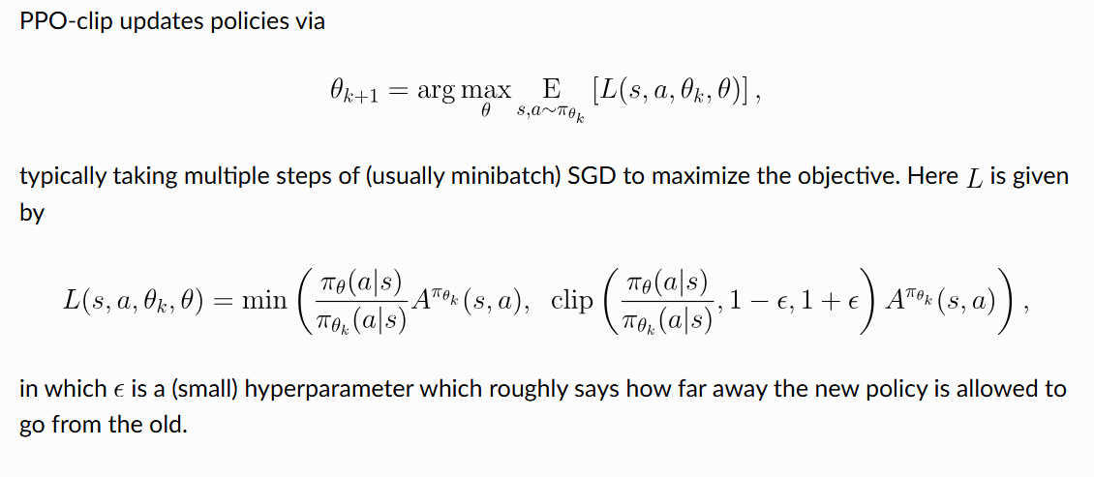
PPO (Clip) Formulation

Slide 11
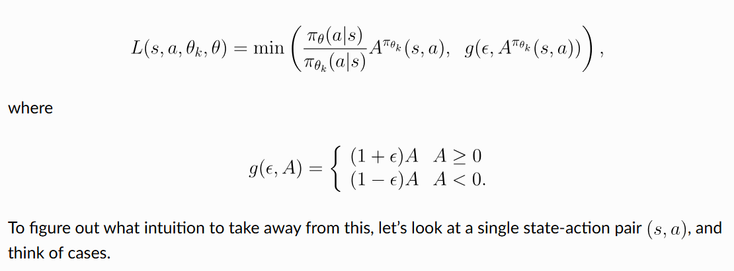
PPO (Clip) Formulation
As it turns out, there’s a considerably simplified version of the clipped loss as shown below

Slide 12
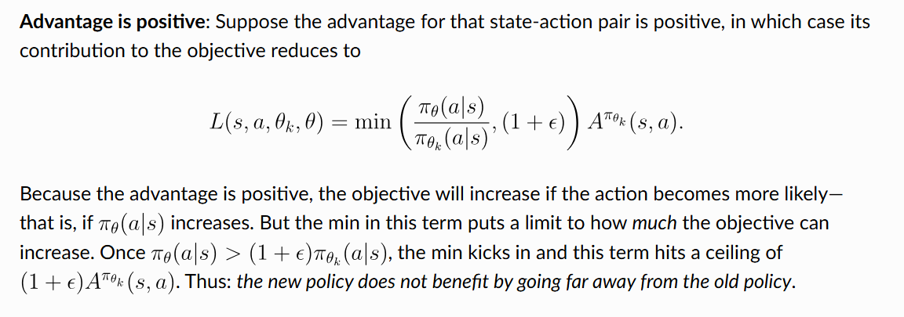
Case 1 – Positive Advantage

Slide 13
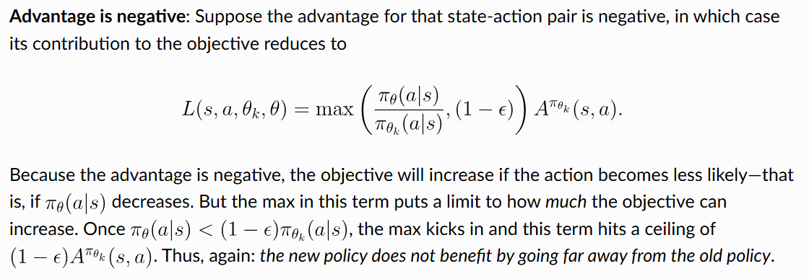
Case 2 – Negative Advantage

Slide 14
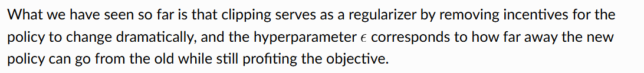
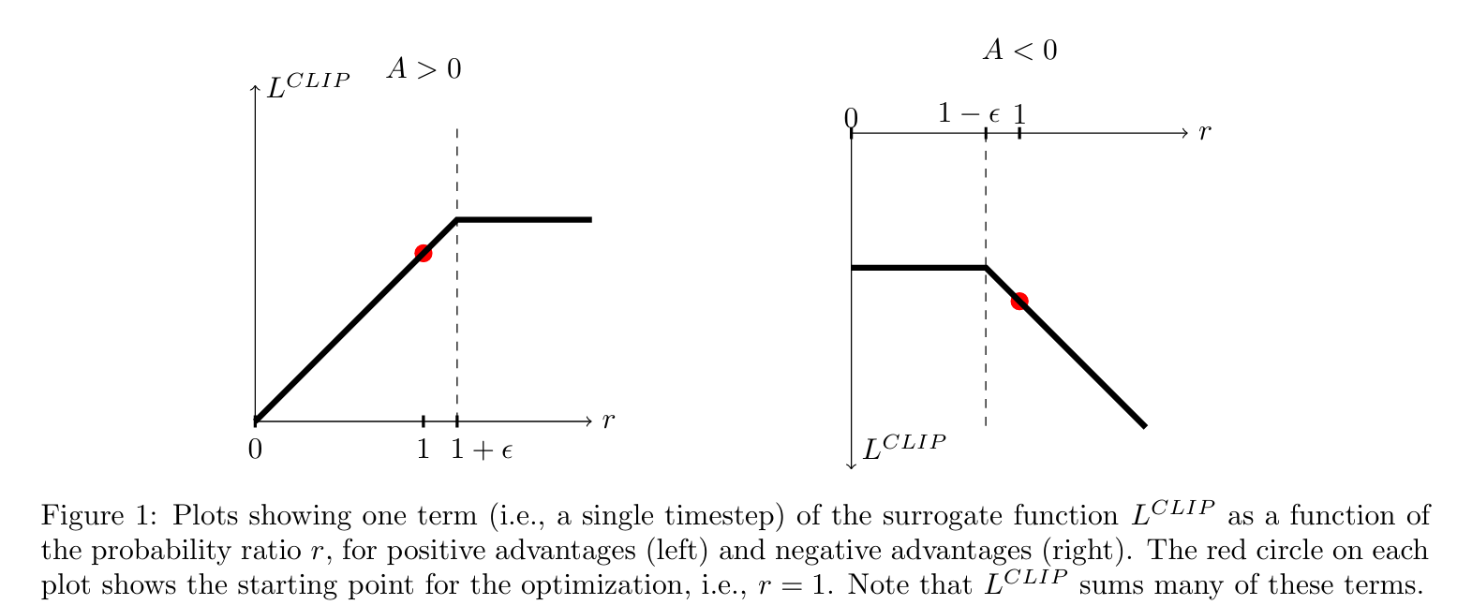
Clipping as Regularization

Slide 15
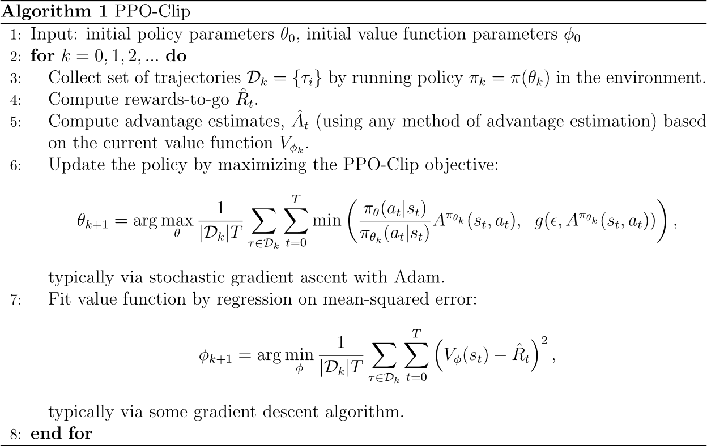

Slide 16
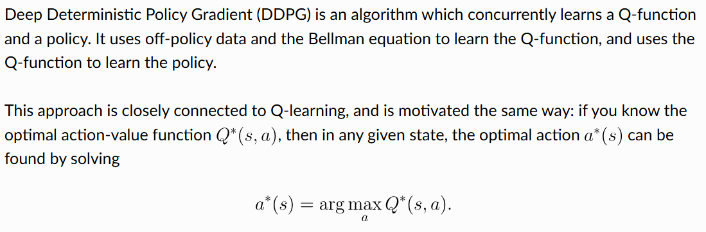
Deep Deterministic Policy Gradient (DDPG)

Slide 17

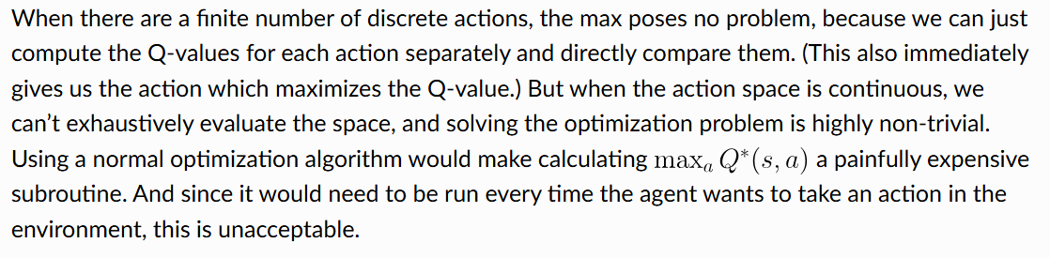
Deep Deterministic Policy Gradient (DDPG)

Slide 18
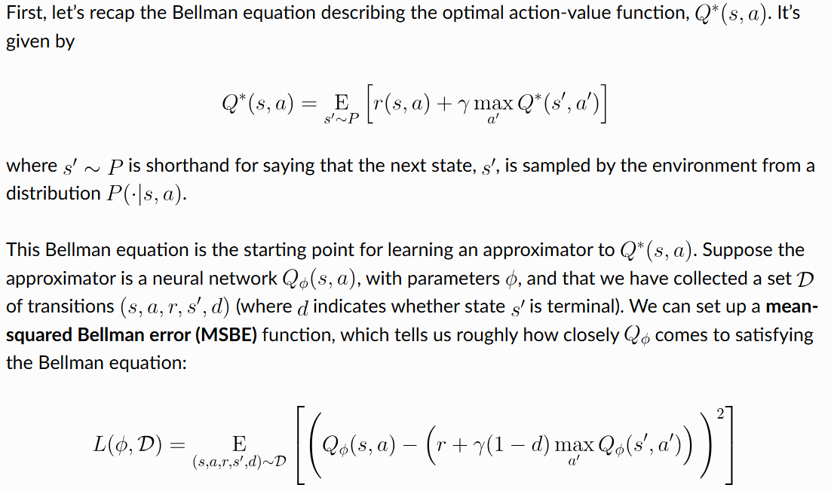
Q-Learning side of DDPG

Slide 19
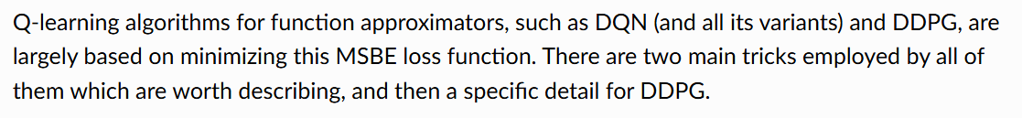
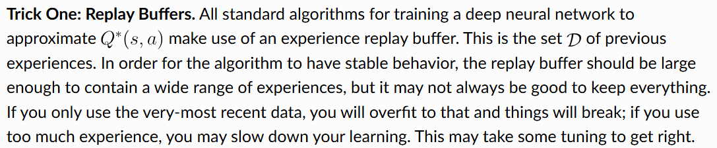
Q-Learning side of DDPG

Slide 20
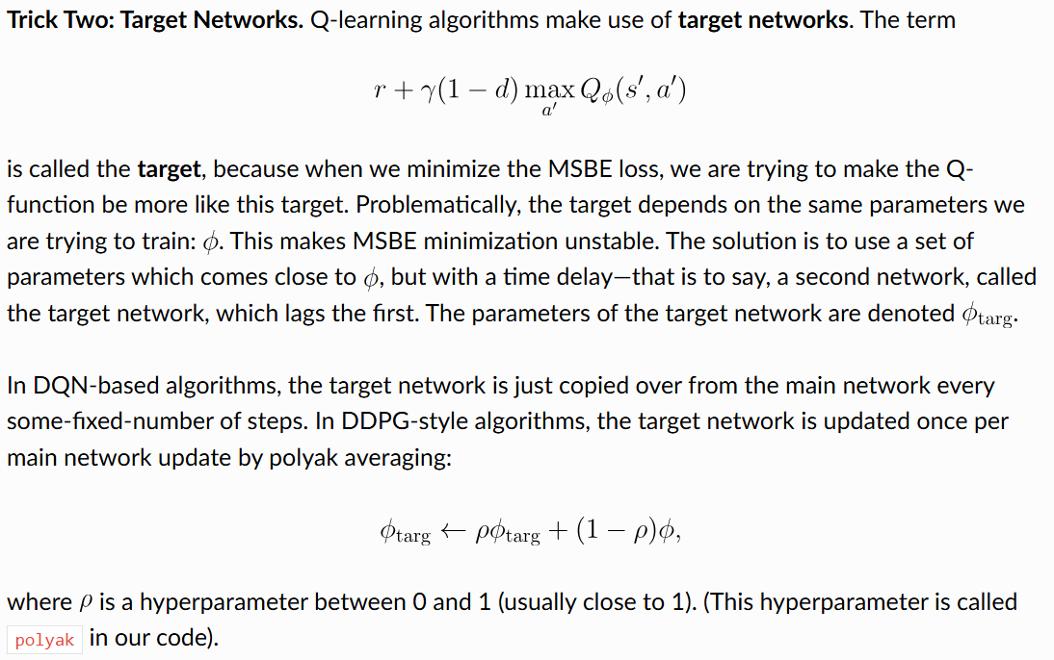
Q-Learning side of DDPG

Slide 21
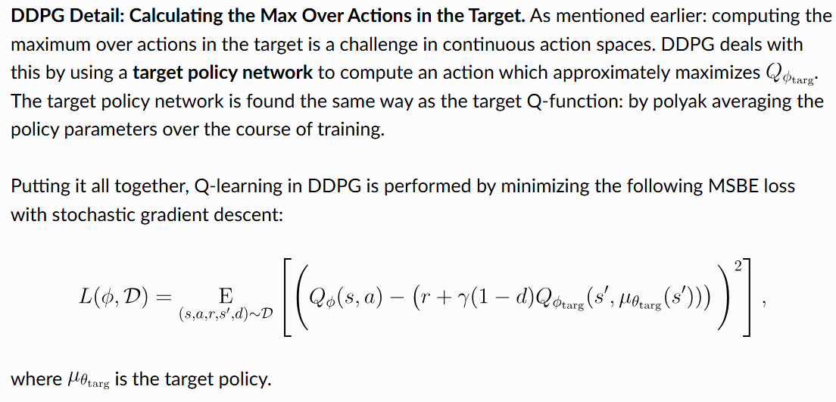
Q-Learning side of DDPG

Slide 22
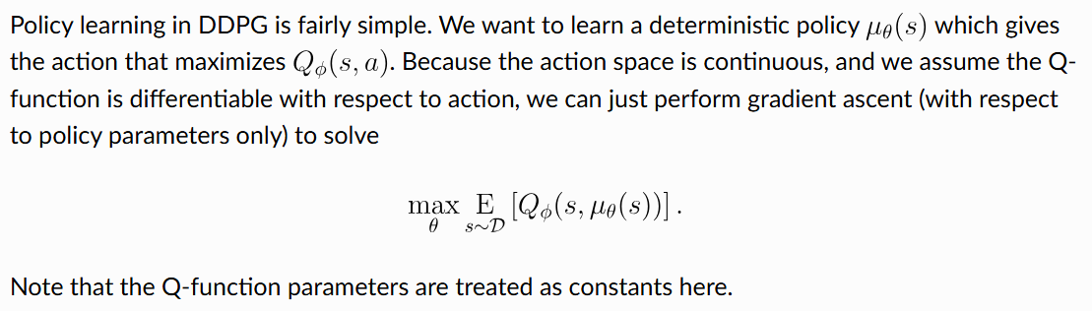
Policy Learning side of DDPG

Slide 23
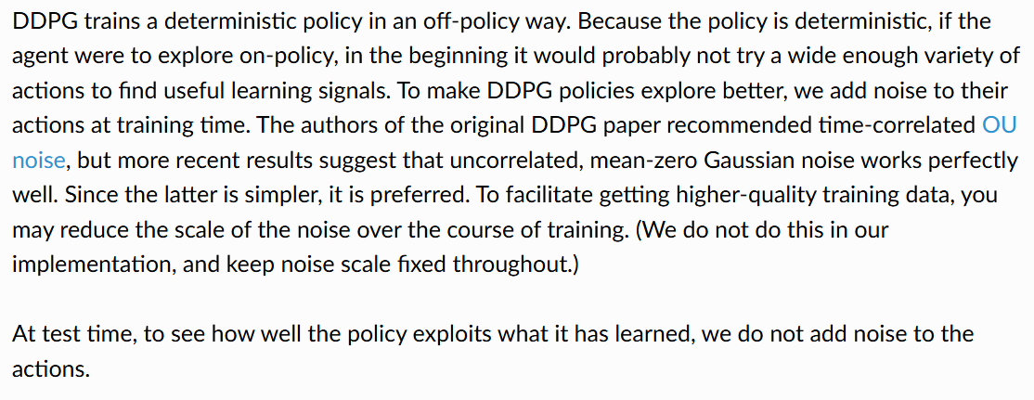
Exploration vs. Exploitation

Slide 24
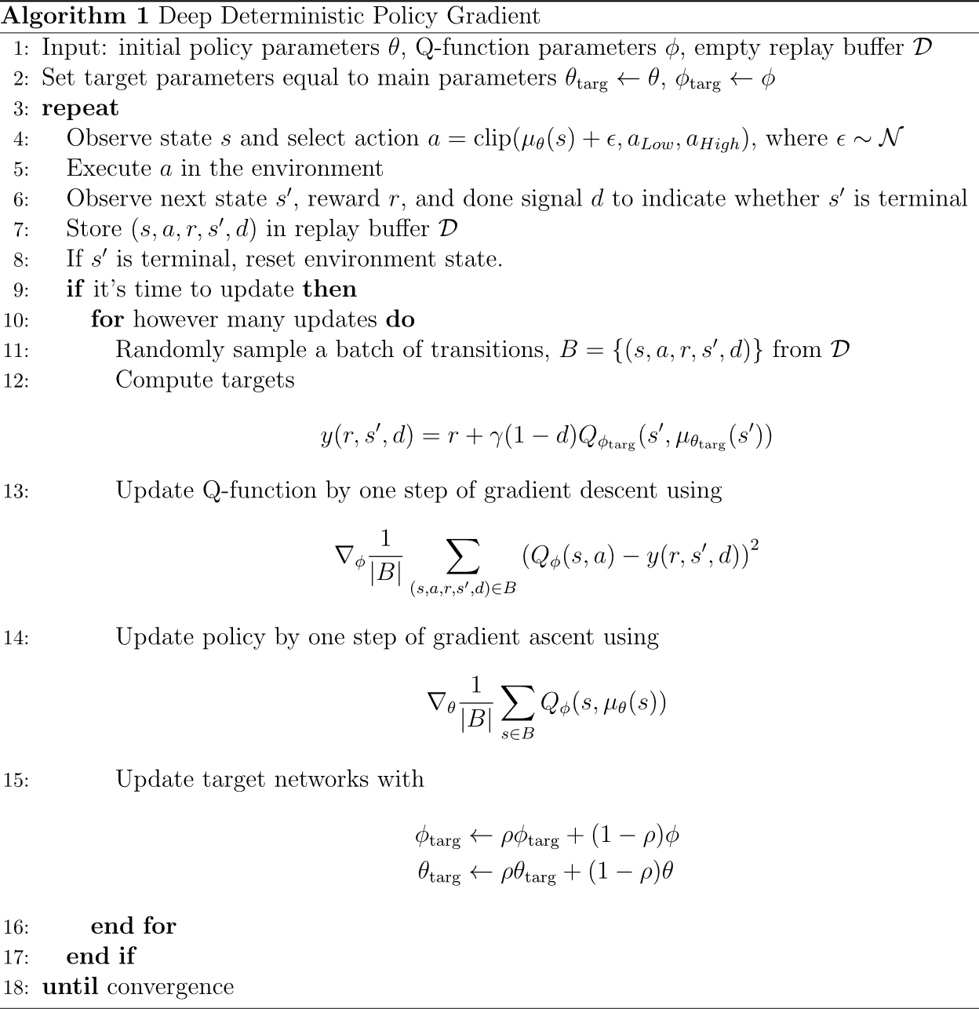

Slide 25
Thank You
Dr. Rajiv Misra, Professor
Dept. of Computer Science & Engg.
Indian Institute of Technology, Patna
rajivm@iitp.ac.in

Slide 26
Summary

